Slide 1
Blockchain Technology
Bitcoin and Beyond
David V Duccini, MSc, MBA, CISSP, IFR Private Pilot, Rescue Diver
aka The Little Duke
http://linkedin.com/in/dvduccini

Slide 2
Agenda
What is a Blockchain
What is Bitcoin
Where did Bitcoin come from?
How does a Blockchain get built
How does a Blockchain get verified
Weaknesses of Blockchain technology
Value
Current applications of Blockchain technology
Future applications of Blockchain technology
Q & A

Slide 3
What do blockchains replace?
Access protected writes to an authoritative database
Transactions, timestamping, contracts, etc.
Database
Validation Rules
Client
Client
Client
Client

Slide 4
What do blockchains replace?
Authoritative access control replaced with distributed consensus
Database state dependent upon majority agreement of update validity
Database
Validator
Validator
Validator
Client
Client
Client
Client

Slide 5
Why?
Authority seems to work pretty well
Distributed consensus can allow:
  Distrustful parties to maintain clean state
  Completely unambiguous rules about validity
  Removing authentication and identity as essential
  Perhaps solves other problems also….

Slide 6
Welcome to Cryptoland
Ugh. Do I have to learn all this detail?
Yes. The laws of crypto are the laws of blockchains and bitcoin. Not understanding this will lead to bad intuitions about what this stuff can and cannot do.
Luckily, only need to understand two laws of cryptography (and believe that people are motivated by incentives, I guess)
We’ll do this by building increasingly complex games that simulate parts of bitcoin and blockchains.

Slide 7
Blockchain Defined
Simply defined a Blockchain is little more than a:
    Distributed
    Secure
    Logfile
A digital currency was in a lot of ways the first demonstrable use

Slide 8
Ingredient #1: Hashes
A hash function (like SHA-256) takes a block of data in, and produces an effectively random fixed size integer.
Any change to the input randomizes it
“The quick brown fox did some crypto”
“The quick brown Fox did some crypto”
SHA-256
SHA-256
410312395834291203…
983249120432492340…

Slide 9
Hash-based Proof of Work
Can’t compute an input from an output
To find a hash with N zeros at the start of the input, requires 2^{N} computations…proves computational work
If we hash an incrementing “nonce” as the hash input, we can go looking for zeros:
in 3e-05 seconds, nonce = 0 yielded 0 zeros. value = 4c8f1205f49e70248939df9c7b704ace62c2245aba9e81641edf…
in 0.000138 seconds, nonce = 12 yielded 1 zeros. value = 05017256be77ad2985b36e75e486af325a620a9f29c54…
in 0.000482 seconds, nonce = 112 yielded 2 zeros. value = 00ae7e0956382f55567d0ed9311cfd41dd2cf5f0a7137…
in 0.014505 seconds, nonce = 3728 yielded 3 zeros. value = 000b5a6cfc0f076cd81ed3a60682063887cf055e47b…
in 0.595024 seconds, nonce = 181747 yielded 4 zeros. value = 0000af058b74703b55e27437b89b1ebcc46f45ce55d6….
in 3.491151 seconds, nonce = 1037701 yielded 5 zeros. value = 00000e55bd0d2027f3024c378e0cc511548c94fbeed0e….
in 32.006105 seconds, nonce = 9913520 yielded 6 zeros. value = 00000077a77854ee39dc0dc996dea72dad8852afbde6….
in 590.89462 seconds, nonce = 186867248 yielded 7 zeros. value = 0000000225060b16117b23dbea9ce6be86ac439d….
in 4686.171007 seconds, nonce = 1424462909 yielded 8 zeros. value = 000000002dd743724609a9f57260e2492908d….
We can now make this into a distributed “game”

Slide 10
Game #1 – The Chain Race
A parameter N sets the difficulty of the game
Players get a list of blocks, with:
  A block number
  A winner number
  A nonce value
  A hash of the previous block
  A hash of the current block with N zeros
Players accumulate points by creating blocks
  Hash the previous block
  Find a hash of the new block with enough zeros
  They then transmit this block to everyone

Slide 11
Game #1 – The Chain Race
Block #0
Winner
nobody
Parent_hash
0
Nonce
0
SHA-256
Block #1
Winner
Player 23
Parent_hash
000D45698
Nonce
3459
SHA-256
Block #2
Winner
Player 16
Parent_hash
000F67839
Nonce
974329

Slide 12
The Nonce / Hash Loop
The algorithm to make a new block:
Verify the hashes of all the previous blocks
Build a new block with a random nonce
Hash the new block. Does it have N zeros?
  No? Go back to Step 2
  Yes? Send your new block to everyone!
Note that as a result of step #1, you can find out how many points anyone has by counting how many blocks they have won

Slide 13
How hard is the game?
For N zeros, because the SHA-256 output is effectively random, getting zero bits = same as flipping a coin and getting N heads in a row
For N zeros, have to try 2^{N}/2 nonces…
  N=1 …. Try 1 nonce
  N = 16 … Try 32768 nonces
  N = 32 … Try 2 billion nonces
Winning a block proves the player did work

Slide 14
What about cheaters?
One way to cheat: make up a fake hash!
What happens then?
  Step 1 in the algorithm will fail for all the other players.
  Other players will not use your block, making it not part of the chain

Slide 15
Ingredient #2: Signatures
Signing key
Public part
454F4D3E1..
Private part
56F23F2D..
Private part
Signing Algorithm
Data
Signature
Public part
Data
Verification Algorithm
Signature
Yes/No

Slide 16
Trading points
Make player ID = public key
We can now make trades by signing messages and sending them to everyone
Signed trades are:
Unalterable
Verifiable by anyone
From key to key, not tied to a
“real” identity
Trade #8423
From
Public_key1
To
Public_key2
Amount
50 points
SIgnature
345349354
Trade #8424
From
Public_key2
To
Public_key3
Amount
50 points
SIgnature
734589345

Slide 17
Game #2 – The Race with Trades
Block #0
Winner Key
nobody
Trade #8423
Parent_hash
0
From
Public_key1
Nonce
0
To
Public_key2
Amount
50 points
Block #1
SIgnature
345349354
Winner Key
045F45F…
Parent_hash
000D45698
Trade #8424
Nonce
3459
From
Public_key2
To
Public_key3
Block #2
Amount
50 points
Winner Key
8234DB4…
SIgnature
734589345
Parent_hash
000F67839
Nonce
3459

Slide 18
Cheating!
Can’t alter transactions, but sneaky players could trade extra points by sending more trades than they have points to cover
“Overtrading” not resolvable, because don’t have an absolute unalterable source of time
Let’s fix this in game #3…
  Critical insight: Put the trades in the blocks.

Slide 19
Game #3 – No-cheating Social
Block #2
Winner_key
6B34C03…
Parent_hash
004539A3F
Nonce
54695
Trade #5
From
Public_key1
To
Public_key2
Amount
50 points
SIgnature
345349354
Trade #6
…

Slide 20
Game #3 is magic…
Players expend effort to get points
Players can trade points securely
  Signatures prevent alteration of trades
  Signatures authenticate the origin of trades
Players can detect overtrading
  Players will decline to extend the game on blocks with overtrades
  If they do, they are wasting effort, since other players will not extend the game on their blocks

Slide 21
Game #3 Problems
Why bother to put trades in your block?
Lets solve this by adding a fee in transactions
  Incent players to add transactions by giving them points per trade added
  Two ways to get points!
Why limit trades to players?
  Let players send points to anyone with a public key….
  This is now a global transaction system

Slide 22
Game #4 – Simplified Bitcoin
Players = “miners”, points = “bitcoins”
Transactions send value (bitcoins) from key to key
The chain race game (blockchain) prevents overspending without a central authority
Game rules = bitcoin node code, changes by miner consensus
Player consensus replaces authority
  Number of coins (limit to 21 million)
  Reward per block
  How difficulty grows

Slide 23
Transition to transactions
Note that player/miners can interact with non-players
Once a point is created, the recipient can create a transaction to any public key
Now can extend to trades with non-miner/players
All points still originate with some block/miner

Slide 24
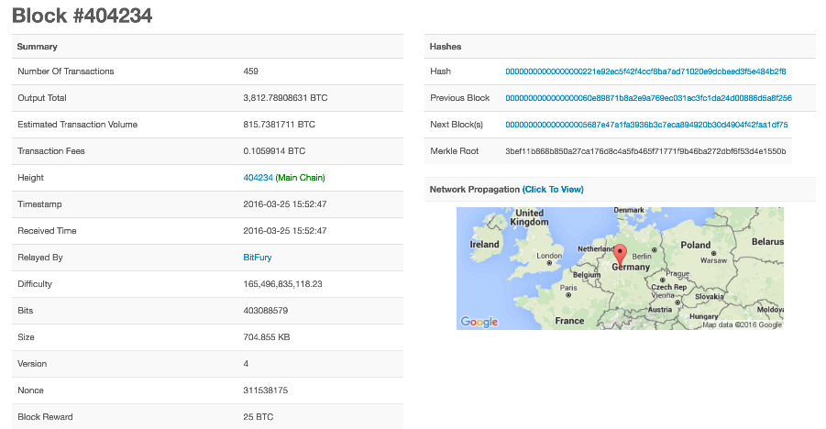
Anatomy of a Block
(from blockchain.info, a great resource for bitcoin info)

Slide 25
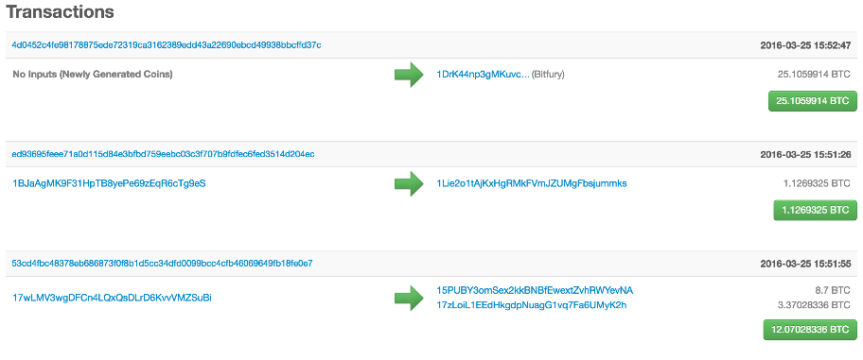
Block Transactions

Slide 26

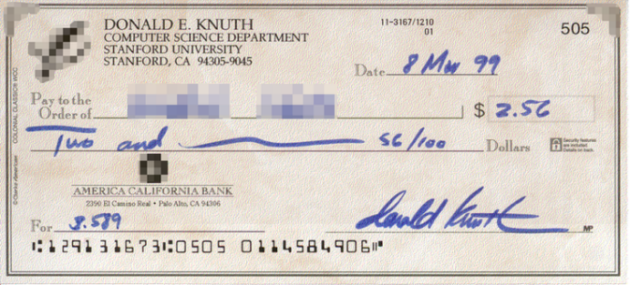
Bitcoin Transactions
Public key 0xc7b2f68...
Public key 0xa8fc93875a972ea
Signature 0xa87g14632d452cd

Slide 27
What is Bitcoin
A protocol that supports a decentralized, pseudo-anonymous, peer-to-peer digital currency*
A publicly disclosed linked ledger of transactions stored in a blockchain
A reward driven system for achieving consensus (mining) based on “Proofs of Work” for helping to secure the network
A “scare token” economy with an eventual cap of about 21M bitcoins
* I would argue it behaves more like a security like a Stock or Bond than a currency, a crypto-equity

Slide 28
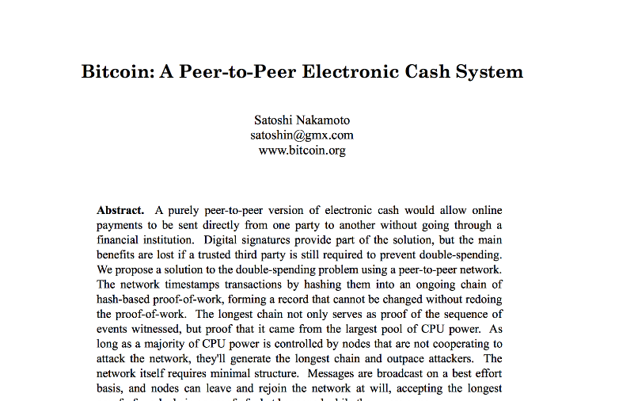
Bitcoin Whitepaper – 2008.10.31*
* Halloween

Slide 29
Features of Bitcoin
Essentially it’s “deflationary” – the reward is cut in half every four years, and tokens can be irrevocably destroyed
Nearly infinitely divisible currency units supporting eight decimal places 0.00000001 (known as a Satoshi or Noncent*)
Nominal transaction fee’s paid to the network
  Same cost to send $.01 as $1,000,000
Consensus driven – no central authority
Counterfeit resilient
  Cannot add coins arbitrarily
  Cannot be double-spent
Non-repudiation – aka “gone baby gone” – no recourse and no one to appeal to return sent tokens
http://www.urbandictionary.com/define.php?term=Noncents

Slide 30
When did it start?
“Satoshi Nakamoto” created the reference implementation that began with a Genesis Block of 50 coins
2008
  August 18 Domain name "bitcoin.org" registered^{[1]}.
  October 31 Bitcoin design paper published
  November 09 Bitcoin project registered at SourceForge.net
2009
  January 3 Genesis block established at 18:15:05 GMT
  January 9 Bitcoin v0.1 released and announced on the cryptography mailing list
  January 12 First Bitcoin transaction, in block 170 from Satoshi to Hal Finney
https://en.bitcoin.it/wiki/History

Slide 31
Bitcoin Network
Each P2P node runs the following algorithm:
  New transactions are broadcast to all nodes.
  Each node (miners) collects new transactions into a block.
  Each node works on finding a proof-of-work for its block. (Hard to do. Probabilistic. The one to finish early will probably win.)
  When a node finds a proof-of-work, it broadcasts the block to all nodes.
  Nodes accept the block only if all transactions in it are valid (digital signature checking) and not already spent (check all the transactions).
  Nodes express their acceptance by working on creating the next block in the chain, using the hash of the accepted block as the previous hash.

Slide 32
Decentralized
The “digital wallet” operates in a peer to peer mode
When it starts it bootstraps to find other wallets
  Originally it used the Internet Relay Chat (IRC) network
  Now based on DNS and “seed nodes”
The wallet will synchronize with the network by downloading ALL of the transactions starting from the GENESIS block if necessary
  338,540 blocks at time of slide prep
  Just over 20 GB
Using a “gossip protocol” the wallets share all transaction information with their peers http://en.wikipedia.org/wiki/Gossip_protocol

Slide 33
Decentralized Bitcoin protocol
1. Who maintains the ledger of transactions?
2. Who has authority over which transactions are valid?
3. Who creates new bitcoins?
4. Who determines how the rules of the system change?
5. How do bitcoins acquire exchange value?

Slide 34
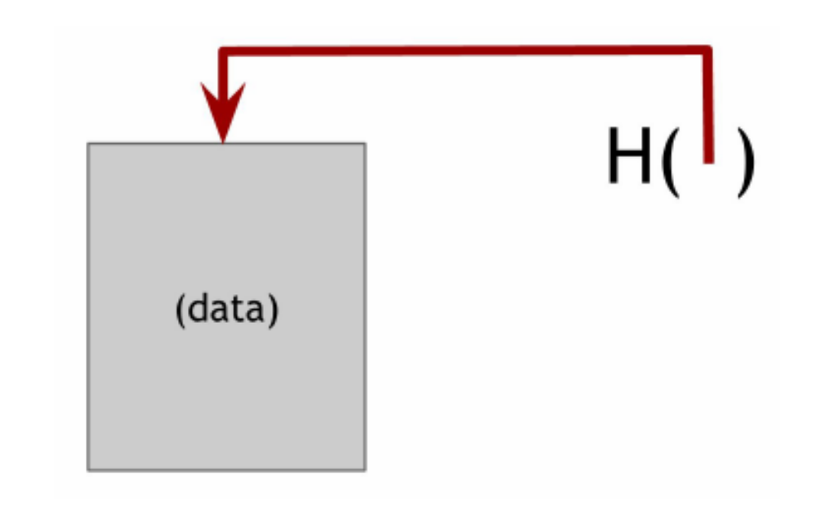
Hash Pointers

Slide 35
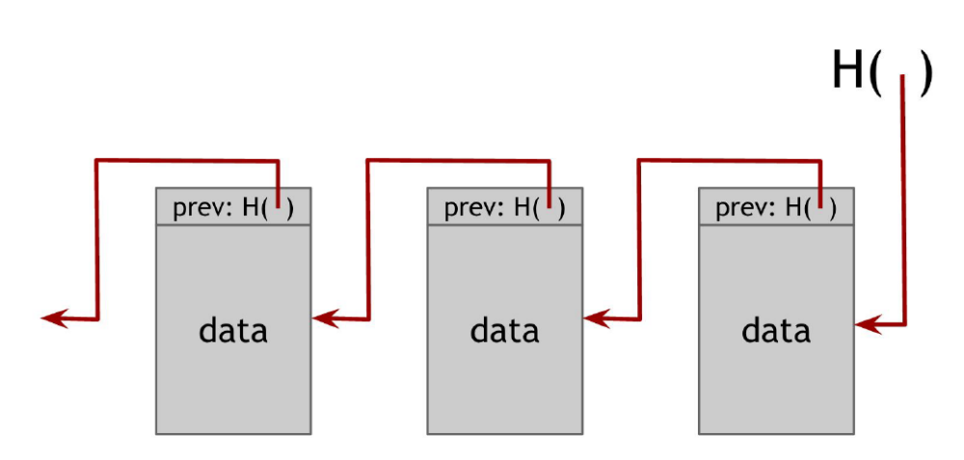
Block chain

Slide 36
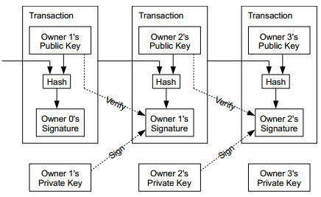
Coins flow from Inputs to Outputs
A coin owner transfers coins by digitally signing (via ECDSA) a hash digest of the previous transaction and the public key of the next owner. This signature is then appended to the end of the coin.

Slide 37
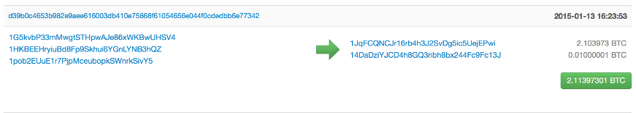
Pseudo Anonymous
Using public key cryptography, specifically Elliptic Curve Cryptography due to its key strength and shorter keys
Transactions are sent to public key “addresses”
1AjYPi8qryPCJu6xgdJuQzVnWFXLmxq9s3
1Give4dbry2pyJihnpqV6Urq2SGEhpz3K

Slide 38
Addresses are like Accounts
The wallet listens for transactions addressed to any of its public keys and in theory is the only node that is able to decrypt and accept the transfer
“Coins” are “sent” by broadcasting the transaction to the network which are verified to be viable and then added to a block
Keys can represent a MULTI-SIG address that requires a N of M private keys in order to decrypt the message

Slide 39
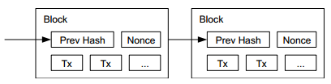
Public Ledger
Every viable transaction is stored in a public ledger
Transactions are placed in blocks, which are linked by SHA256 hashes.
https://blockchain.info

Slide 40
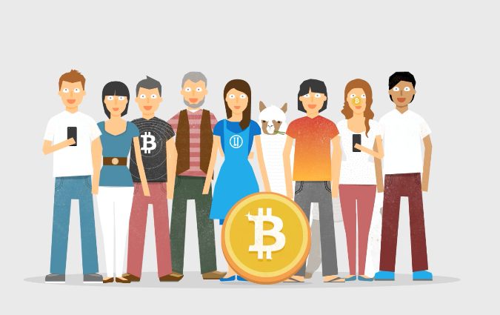
“What is Bitcoin” – Video
http://weusecoins.com

Slide 41
Bitcoin consensus algorithm
This algorithm is simplified in that it assumes the ability to select a random node in a manner that is not vulnerable to Sybil attacks.
1. New transactions are broadcast to all nodes
2. Each node collects new transactions into a block
3. In each round a random node gets to broadcast its block
4. Other nodes accept the block only if all transactions in it are valid (unspent, valid signatures)
5. Nodes express their acceptance of the block by including its hash in the next block they create8rt

Slide 42
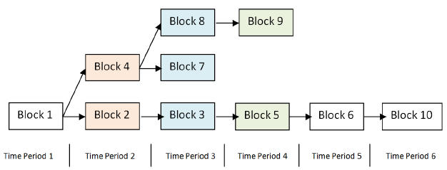
Arriving at Consensus
Although the accepted chain can be considered a list, the block chain is best represented with a tree.
The longest path represents the accepted chain.
A participant choosing to extend an existing path in the block chain indicates a vote towards consensus on that path. The longer the path, the more computation was expended building it.

Slide 43
Consensus Process = Mining
Originally the digital wallet could also participate in the consensus process by attempting to secure the network directly
This process is known as “mining”
Mining involves attempting to find a numerical value, known as a “nonce” that when combined with all open transactions can be “hashed” into a value that satisfies a certain “difficulty”
Custom, purpose built-hardware has long since replaced the function such that its no longer productive for simple CPU based systems to compete in the mining process, and thus it was removed

Slide 44
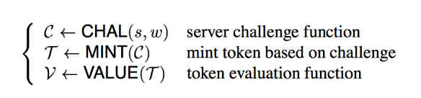
Hashcash
(Or How to Pay a Byzantine Generals Salary)
Like many great ideas to become realized, it takes a confluence of other great ideas
Based on the idea of HashCash, a Proof of Work concept invented by Adam Back in 1997 (http://www.hashcash.org/papers/hashcash.pdf)
Originally proposed as an anti-spam throttling mechanism
The core idea is that before accepting a transaction, the sender must first demonstrate a “cost” via a computationally “hard” problem that can simultaneously be easily verified.
This generally referred to as a “Proof of Work”

Slide 45
The Role of Hashing
A hash function is any function that can be used to map digital data of arbitrary size to digital data of fixed size, with slight differences in input data producing very big differences in output data.
MD5, SHA1, SHA256
For example, the MD5 hashes of ‘abc’ compared to ‘abC’
abc
0bee89b07a248e27c83fc3d5951213c1
abC
2217c53a2f88ebadd9b3c1a79cde2638
“The Quick Brown Fox Jumped Over the Lazy Dog”
2dfd75162490ed3b4c893141f9ab37cf

Slide 46
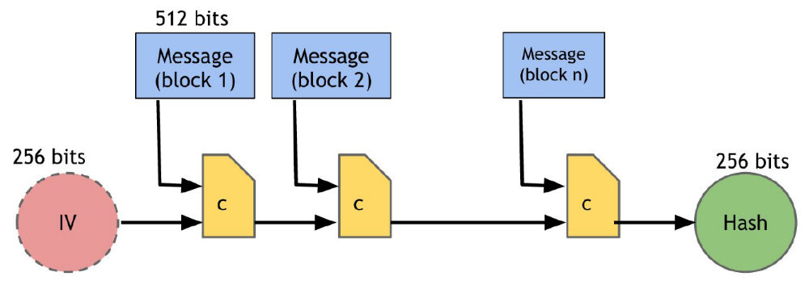
SHA256

Slide 47
Proof of Work
A publicly auditable cost-function can be efficiently verified by any third party without access to any trapdoor or secret information.
A fixed cost cost-function takes a fixed amount of resources to compute. The fastest algorithm to mint a fixed cost token is a deterministic algorithm.
A probabilistic cost cost-function is one where the cost to the client of minting a token has a predictable expected time, but a random actual time as the client can most efficiently compute the cost-function by starting at a random start value. Sometimes the client will get lucky and start close to the solution.

Slide 48
The Hash Lottery
Hashing is straightforward, but not challenging
Unless the goal is to say, find me a hash value that satisfies a certain level of “difficulty”
For example, let’s say the challenge is find a hash-value that begins with a number of zeros, for a given input
The Proof of Work comes from finding a number (known as a NONCE) that when added to the input changes the output of the hash value to satisfy the difficulty.
In the Bitcoin world this is what “mining” is and in effect is little more than a lot of hash-power spent on guessing winning lottery numbers that satisfy the difficulty of the problem in order to obtain the reward from the network

Slide 49
The Payout
The node that finds the best solution to the challenge is provisionally granted a reward
Originally in Bitcoin it was 50 new coins
Competing solutions are evaluated based on which node offers the higher number of transactions included in the candidate block as well as the level of over-satisfying the difficulty.
For example, if two nodes offer a solution to the challenge and both have the same number of transactions, the reward will go to the node that found a NONCE that beat the challenge
  E.G. Find a hash that begins with 4 zeros
  The node that supplies a hash that has 5 zeros beats the node that only finds the minimum

Slide 50
Transaction Confirmation
Having a transaction provisionally accepted into a candidate block signals that the network has verified that the inputs were viable
Every new block accepted into the chain after the transaction was accepted is considered a confirmation
Coins are not considered mature until there have been 6 confirmations (basically an hour assuming a 10 minute block cadence)
New Coins created by the mining process are not valid until about 120 confirmations
This is to assure that a node with more than 51% of the total hash-power does not pull off fraudulent transactions

Slide 51
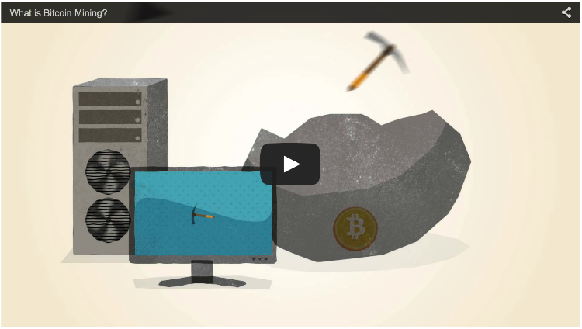
“What is Bitcoin Mining” – Video
http://www.bitcoinmining.com

Slide 52
Why 51% Matters
“When does 1 + 1 = 3 ?” *
In the case of Bitcoin “consensus” goes to the chain with the highest number of blocks
Not just in theory, but in practice several large mining pools have generated six blocks in a row
To date the network has voluntarily shifted its mining power around or faced Distributed Denial of Service attacks
* When everyone says it does!

Slide 53
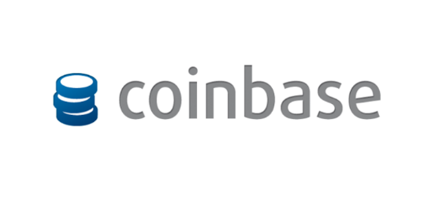
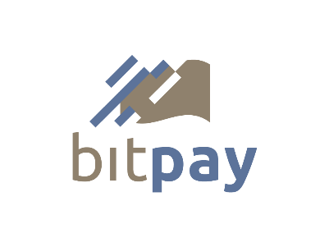

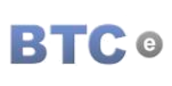
Purchase / Exchange Bitcoins
In addition to mining bitcoins, they can be acquired from an exchange!

Slide 54

Who Accepts Bitcoins?

Slide 55

Merchants Accepting Bitcoin
Overstock.com
Newegg.com
Microsoft XBOX Network
Telsa Motors
Time Inc (publisher)
Virgin Galactic
Wordpress
BitPay claims 44,000 merchants!
http://www.bitcoinvalues.net/who-accepts-bitcoins-payment-companies-stores-take-bitcoins.html

Slide 56
Other Uses of Blockchain Tek
Registeries
Authoritative Systems of Record
Directory Services
Timestamping Services (“Proof of Existence”)
Counter-party Exchanges

Slide 57
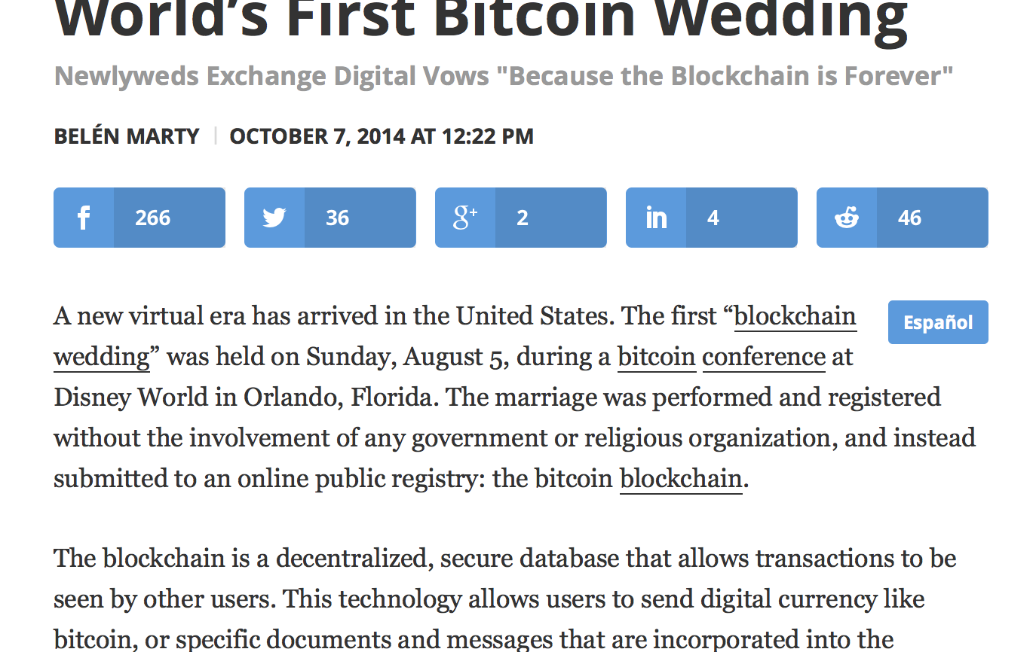
Registries

Slide 58
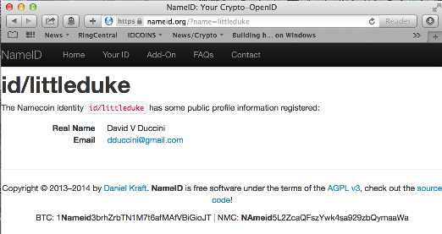
Namecoin
The first fork of Bitcoin with a purpose
Securely record and transfer arbitrary names (keys).
Attach a value (data) to the names
(up to 520 bytes, more in the future).
Transact namecoins, the digital currency (ℕ, NMC).

Slide 59
Namecoin as a fault-tolerant Domain Name System
Can act as a decentralized Domain Name Service that is resilient to censorship
http://bit.namecoin.info

Slide 60
Alternates to Bitcoin aka Altcoins
“Good artists copy. Great artists steal.”
The first alternate blockchain was Namecoin
Early attempts to “re-level the playing field” were made by changing the hashing function from SHA256 to SCRYPT
SCRYPT is a “memory intensive” function that was thought to be resistant to customized hardware (false)
Changes to the block emit time target were also changed from Bitcoins 10 minutes to 2.5 minutes to increase the velocity
Newer ALTS incorporate every escalating hash functions, chained together in novel ways to resist giving purpose built hardware an advantage over CPU based mining

Slide 61
A Babel of Altcoins
Now well over 500 “alternate” coins to Bitcoin
99.999% of them are simply brands / clones
Most tinker with:
  the total coin supply
  the hashing functions (SHA256, SCRYPT, X11 et al)
  block emit time targets
  Proof of Something (Proof of Work, Proof of Stake)
Notable Alts: Ripple, Litecoin, Dogecoin
Total Market Cap: $ 4,540,315,390 (Bitcoin is 3.6B of that)
http://coinmarketcap.com

Slide 62
Bitcoin 1.5
COUNTERPARTY.ORG
Counterparty works by storing extra data in regular Bitcoin transactions, which makes every Counterparty transaction a Bitcoin transaction, albeit a very small one.
MASTERCOIN.ORG
The Master Protocol facilitates the creation and trading of smart properties and user currencies as well as other types of smart contracts.
Mastercoins serve as the binding between bitcoins (BTC), smart properties and smart contracts created on top of the Mastercoin Protocol.
NXT.ORG
Asset creation and exchange on its own blockchain

Slide 63
Bitcoin 2.0
Smart Contracts
  Escrow-free exchange
  Insurance
Voting
Distributed Autonomous Organizations
Identity & Reputation Systems
  http://bit.ly/idcoins
Notable Implementations

Slide 64
Ethereum.org
Turing complete contracts on a blockchain.
Contracts are the main building blocks of Ethereum.
A contract is a computer program that lives inside the distributed Ethereum network and has its own ether balance, memory and code.
Every time you send a transaction to a contract, it executes its code, which can store data, send transactions and interact with other contracts.
Contracts are maintained by the network, without any central ownership or control.
Contracts are written in languages instantly familiar to any programmer and powered by Ether, Ethereum's cryptofuel.

Slide 65
Bad Uses for Good Technology
“Guns Don’t Kill People. People Kill People”
Bitcoin has had its fair share of “bad press”
Silk Road
  An online anonymous marketplace for “censorship-free” commerce
  Ross Ulbricht’s trial starts this week
Bitinstant
  Charlie Shrem plead guilty to aiding money laundering
MT-GOX
  aka “Magic The Gathering Online eXchange”
  700,000 coins “missing”
Neo & Bee
Bitstamp

Slide 66
Resources
Bitcoin: A Peer-to-Peer Electronic Cash System https://bitcoin.org/bitcoin.pdf
http://coinmarketcap.com
Hashcash.org
IDCoins: A Web of Trust Blockchain for Identity and Reputation, David V Duccini, http://bit.ly/idcoins
“Mastering Bitcoin”, Andreas M.Antonopoulos , O’Reilly Media
http://www.bitcoinsecurity.org/2012/07/22/what-is-bitcoin/
https://www.weusecoins.com

Slide 67
Q&A
?

